Slide 1
Study Guide for Quiz #1
09182024

Slide 2
A Brief History of Computing
Focus:
Create new types of businesses
Focus:
Extreme Productivity
High
Focus: Ecommerce & Social Media &
Marketing
Focus: Automation of manual tasks
Gen AI
Web3
Digital Transformation
(Big Data, ML, blockchain, crypto, cloud)
Web 2.0
Level of Business Disruption
Internet
Static Websites
Mobile Apps
Social Media
Web 1.0
The era of the mainframe
Personal Computer
Client Server Computing
Low
‘50’s - 1980’s
‘80’s - ‘90’s
‘90’s - mid 2000’s
mid 2000’s - Present
2022 - Present
Notes:
Some executives will be leary of any technology change, especially something as hyped as Gen AI. You may be in a situation where you have to describe the major shifts in the industry and impress the fact that some shifts are larger and more significant than others. Gen AI is one such shift - as significant as going from mainframes to client-server computing to the internet, cloud and now AI, ML and Gen AI.
You should be able to explain this in your own words.

Slide 3
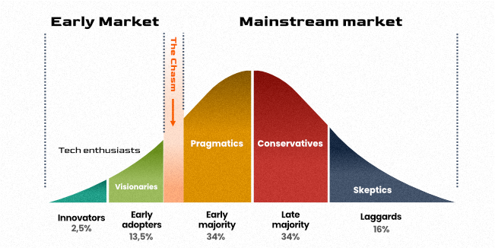
Technology Adoption Curve
What type of company do you want to work for?
https://mdevelopers.com/blog/technology-adoption-curve-everything-that-you-need-to-know
Notes:
Some executives may be concerned they’re not adopting technology fast enough or too fast or too late. You have the opportunity to educate the executives that all companies are somewhere on the Technology Adoption Curve. What you see today is that company that is an Innovator or Early Adopter, are the ones implementing Gen AI. Other companies will take a more ‘wait and see’ approach. It’s up to each company and the industry they’re in that places them somewhere on the above chart.
Be able to explain this chart in your own words.

Slide 4
Is Adopting Gen AI a Technology issue or Culture issue?
A culture issue!
More than technology changes when adopting Gen AI
The entire organization must change!
Finance - How does the Finance operations change?
Audit / Compliance - New policies needed for bias and hallucinations
HR - new roles, descriptions, salary ranges and job postings
SW development processes - how you develop SW will be different with use of AI
Your existing business processes & business model need to be changed to take full advantage of Gen AI
Notes:
Any large adoption of technology (especially Gen AI) is first a cultural issue and second, a technology issue. There’s more that needs to change in order to adopt Gen AI. Business processes will need to change. How a company uses Gen AI to reduce cost AND increase revenue will have to be determined.
Many business functions will need to change (see slide).
Be able to explain this in your own words.

Slide 5
AI Maturity Assessment
Please review the document: Gen AI Maturity Assessment
https://ublearns.buffalo.edu/d2l/le/content/241670/viewContent/4313624/View
Be able to describe the assessment process and two of the dimensions used to measure an organization:
Culture
Strategy
Leadership Commitment and Vision
Data Infrastructure and Architecture
Data Quality
AI Skills
AI Policies and Guidelines
Change Management Processes in Place

Slide 6
Consulting Concepts
Term / Skill | Explanation
Consultant | A person in a position of influence Has NO direct power to make changes or implement programs! When you give advice - you’re acting as a consultant
Manager | A person with direct responsibility to make changes or implement programs
Surrogate Manager | A consultant that starts to act like they can make changes or implement programs! Beware of this behavior! It may feel satisfying, but in the end, the change will most likely not last for long!
Technical skills | Be an “expert” in your field. E.g. Generative AI
Interpersonal skills | Communication skills Able to disagree reasonably Build and maintain a relationship
Consulting skills | Able to reduce large amounts of information to a manageable size Accurate discovery Involving the client & building client ownership Able to make compelling recommendations
Notes:
It’s important to realize you’re always a consultant - either an internal consultant, an informal consultant or even an external consultant. Know the definition and the difference between a Consultant and a Manager. You will act differently based on the role.

Slide 7
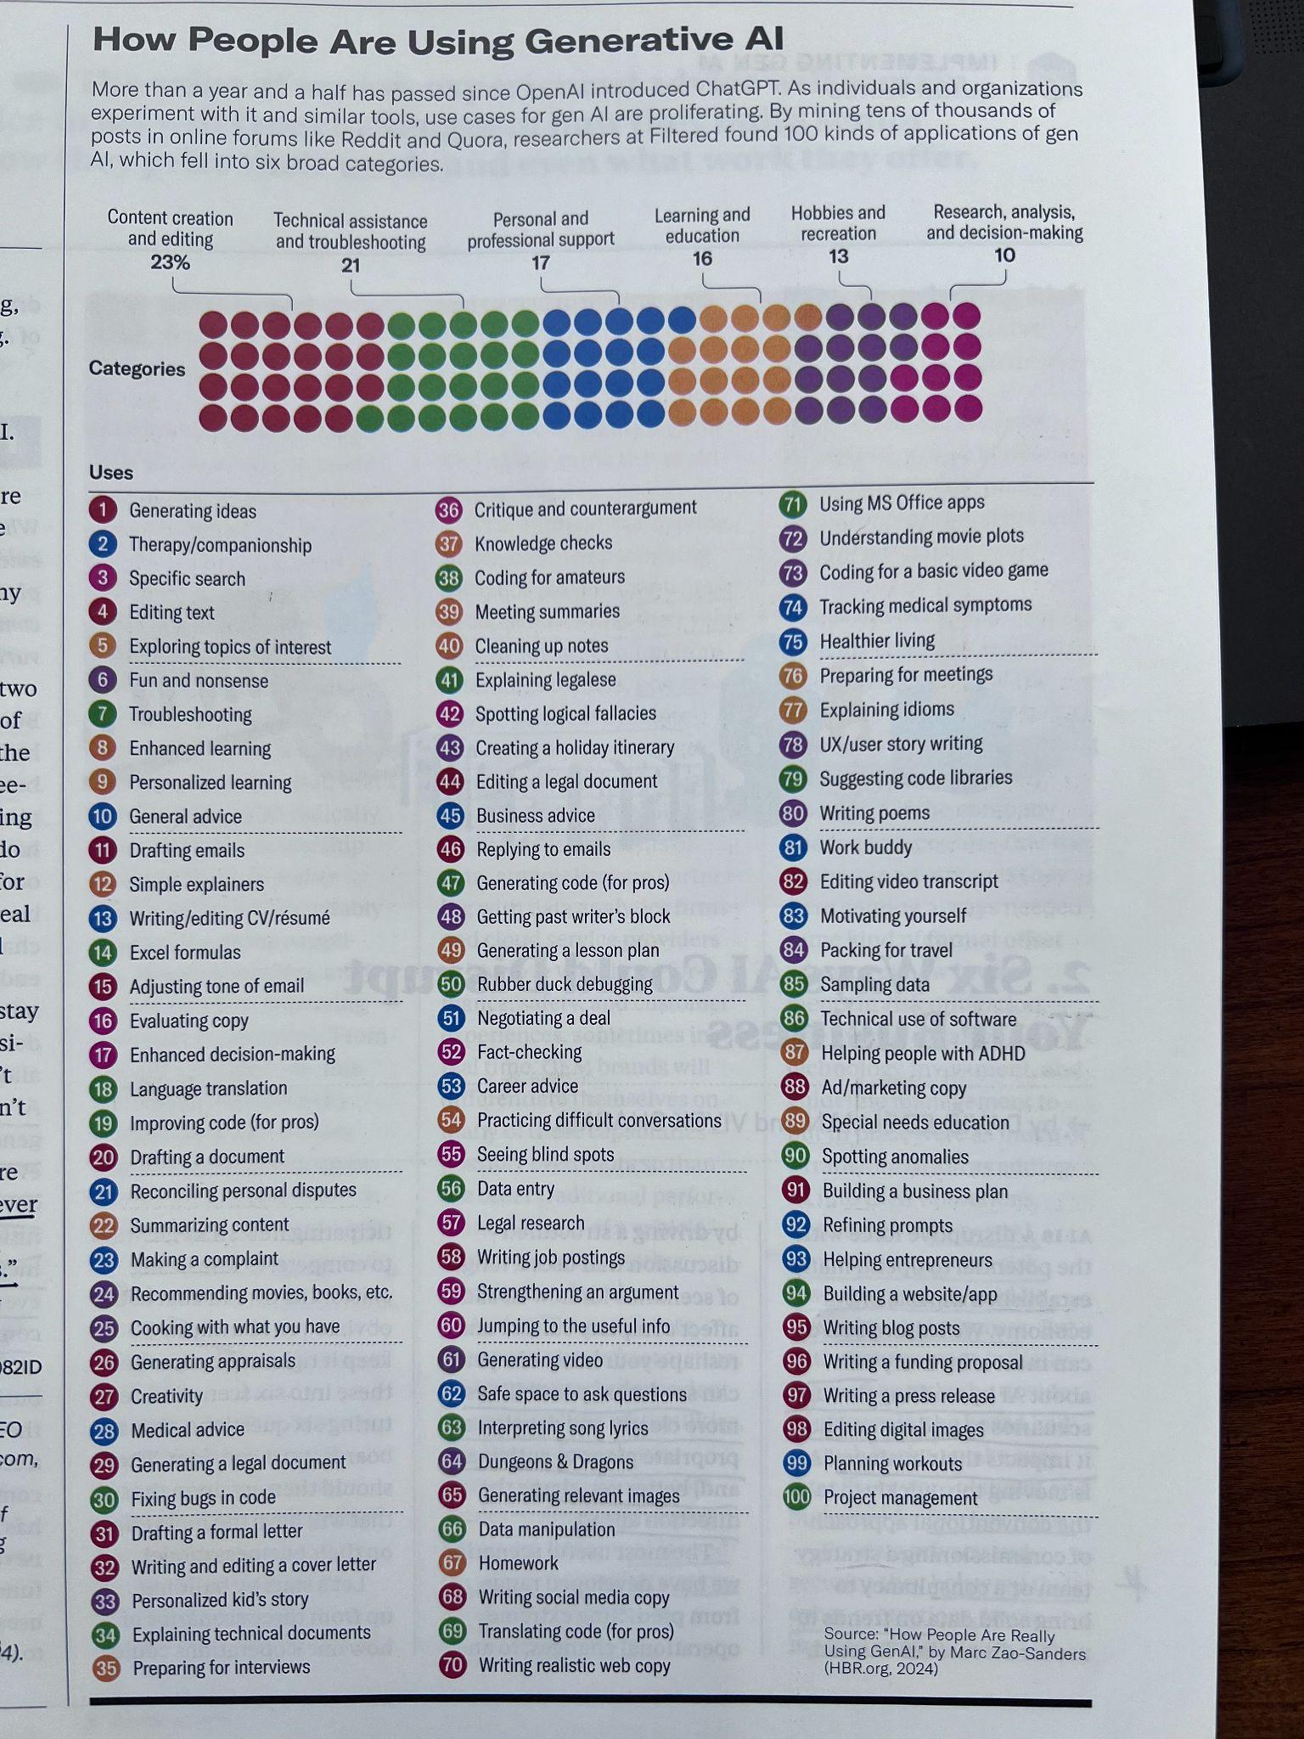
Survey: How people are using Gen AI
In-class Exercise:
Review 9 ways people are using Gen AI and classify in the following groups:
1 | Fully impacts revenue
2 | Impacts revenue and a small cost component
3 | Impacts revenue and cost equally
4 | Impacts some revenue and mostly cost
5 | Fully impacts cost
Provide a count for each group
Present at the end of class
Notes:
Please review the document: How People Are Using Gen AI. The document is an easier view of the picture in the slide. Be able to explain a couple of use cases - everyone did a great job with the in-class exercise where you used different persona’s to describe the use and implications of a use case. “Viewing movie plots” is great fun when I’m home just messing around with Chat GPT. But If I’m a movie executive, I want to know this information and make sure my movie plots are in the training data!
Be able to describe two use cases of Gen AI. You are not limited to the above list.

